Slide 1


Exploratory Data Analysis on Zomato : Unveiling Global Business Trends
Dinesh K

Slide 2
Dataset Source - https://www.kaggle.com/
Tools used - Jupyter notebook
Language and Packages used - Python (Pandas, NumPy, Matplotlib, Seaborn)
Access the files related to the project at link

Slide 3
Data Cleaning
Data cleaning is a crucial step in the analysis process as it ensures data accuracy, completeness, consistency, and reliability.
It helps mitigate errors, improve the quality of results, and enables more informed decision-making based on trustworthy data.
Thorough checking and cleaning of the dataset were conducted to ensure data integrity.
Missing values were handled by filling them with "Not Specified" to facilitate seamless exploration.

Slide 4
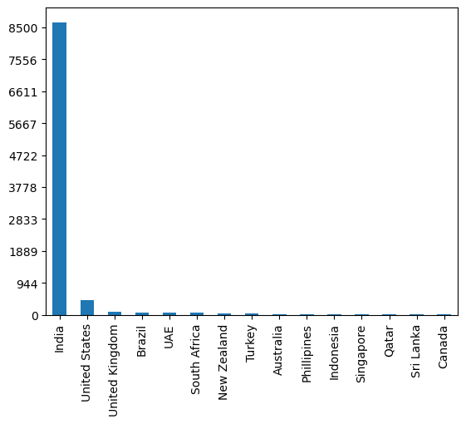
Data Exploration - Countries Providing Service
India dominates with 90% of the recorded transactions.
Followed by the USA and the UK, which together account for 5% of the transactions.

Slide 5
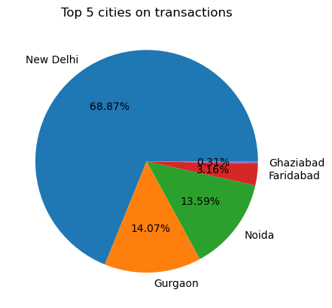
Data Exploration - Top 5 Cities
New Delhi has the highest number of transactions (68.87%)
Gurgaon (14.07%)
Noida (13.59%)
Faridabad (3.16%)
Ghaziabad (0.31%)

Slide 6
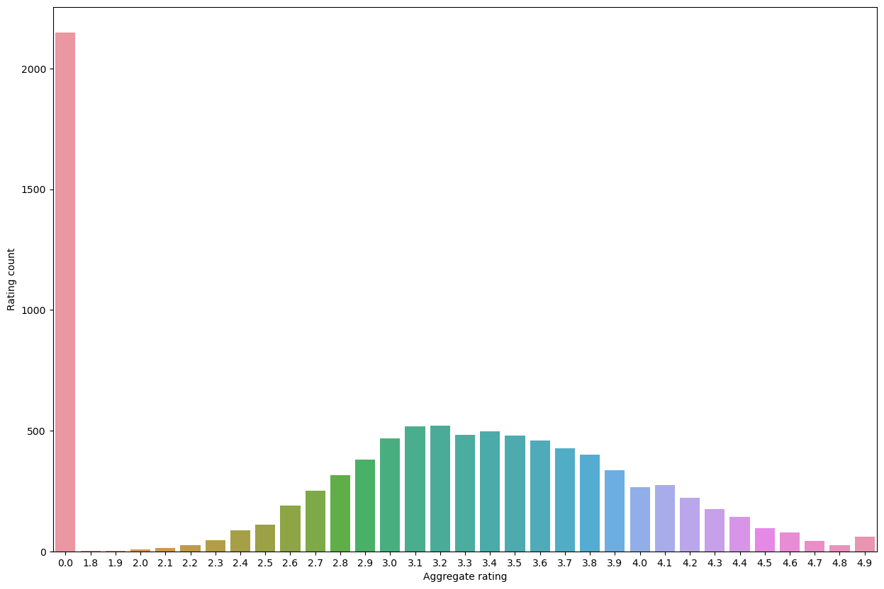
Data Exploration - Customer Ratings Provided
Majority of the customer ratings for restaurants are between 2.8 to 4.1 .
Significant majority of customers preferred not to rate the restaurants.
No restaurant received a perfect 5-rating.

Slide 7
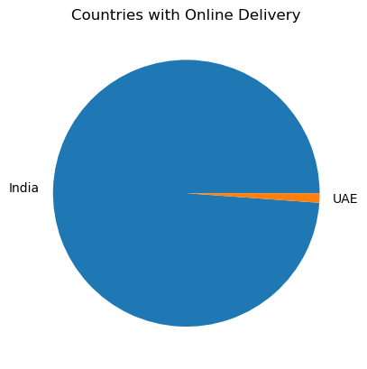
Data Exploration - Online Delivery of Food Items
Only India and the UAE offer online delivery through Zomato.
Only 1/4th of restaurants in India offers online delivery.

Slide 8
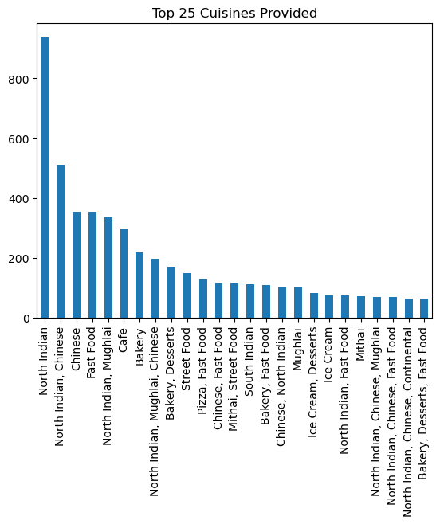
Data Exploration - Cuisines Provided by Restaurants
North Indian cuisine is the most prevalent, followed by Chinese, Fast food, and Mughlai cuisines.
Cafe and Bakery cuisines are also among the top 10 providers.

Slide 9
Key Insights Summary
Zomato records maximum transactions from India that is 90% and then USA and UK which accounts for 5% combined.
In India , New Delhi (68.87) records maximum transactions followed by Gurgaon (14.07) and Noida (13.59). image
Majority of customers preferred not to rate the restaurants.
Also no restaurant has got 5-rating.
Maximum number of 0 ratings are from Indian customers .
Majority of the customer ratings for restaurants are between 2.8 to 4.1 .
Only India and UAE offer online deliveries.
Only 1/4th of restaurants in India offers online delivery.
Most of the restaurants provide North Indian cuisine followed by Chinese, Fast food and Mughlai cuisines.
Cafe and Bakery cuisines are in top 10 Providers.

Slide 10
Conclusion and Next Steps
Overall, this project highlighted the significance of exploring the Zomato dataset, providing valuable insights into transaction patterns, customer preferences, and cuisine offerings.
The findings contribute to a deeper understanding of the restaurant business, enabling data-driven decision-making for restaurant owners, managers, and stakeholders.
Further analysis and exploration can be conducted to delve deeper into specific aspects of the dataset.

